Slide 1

Applied Data Science MS Portfolio
Logan Roach
2024

Slide 2
Outline
Introduction – Program Learning Outcomes
Projects Demonstrating Learning Outcomes:
Business Analytics: Developing Enhanced Marketing Strategies from Previous Campaigns
Marketing Analytics: Segmentation for Business Intelligence Insights
Applied Machine Learning : Predicting the Winner of The Rugby World Cup
Deep Learning: Recursive Neural Networks In Financial Markets
Natural Language Processing: Predicting Sentiment using NLP Techniques
Text Mining: Filtering Resumes Using Text Mining
Summary of Learning Outcomes and Conclusion
Notes:
Program Goal: Mastering the Data Science techniques while also being able to apply them to analyze, interpret and clearly recommend data driven solutions to stakeholders in organizations.

Slide 3
Program Learning Outcomes
Collect, store, access data by identifying and leveraging applicable technologies.
Create actionable insight across a range of contexts.
Apply visualizations and predictive models to generate actionable insights.
Use programming (R and Python) to support the generation of actionable insights.
Communicate insights via visualizations and analytics to broad audiences.
Apply ethics in the development, use and evaluation of data and predictive models.
Notes:
Program Goal: Mastering the Data Science techniques while also being able to apply them to analyze, interpret and clearly recommend data driven solutions to stakeholders in organizations.

Slide 4

Demonstrating Learning Outcomes
Applied Data Science MS
Projects and Assignments

Slide 5

Business Analytics: Developing Enhanced Marketing Strategies from Previous Campaigns
Goal: Analyze previous advertising campaigns for the Whitman School of Management at Syracuse to determine the important factors that led to previous effective advertising campaigns and apply them in future campaigns
Identifying Key Features:
Cost per Click (CPC) 2024
Cost per Student (CPS) 2024
Geographic Regions
Campaign Key Words
Optimizing Campaign Time
Notes:
The first project I want to begin come from my Business Analytics Class where the project entails developing an enhanced marketing strategy using data from previous marketing campaigns. The goal of the project was to analyze previous advertising campaigns from the Whitman School of Management at Syracuse and determine the important factors that led to previous effective advertising campaigns and apply them in future marketing campaigns.
The different tools used in this project were Google Analytics and Microsoft Excel. Google Analytics was used to gather data and identify key features from previous campaigns, and Excel was used to generate actionable insights from the previous campaign data. The data was anonymized, and all ethical considerations were observed when handling the data.
A prediction analysis was done to find the Cost per Click (CPC), and Cost per Student (CPS) in 2024. Next Google Analytics was leveraged to identify key features of previous successful campaigns including specific geographic regions to target, specific key words that led to successful campaigns, and finally finding the optimal times to advertise to prospective students.
Data Collection and Exploration
Cleaning and Identifying Features For Analysis
Google Analytics
Finding significant variables within the data
Need to make sure information is handled ethically
Using Analytical Techniques to Explore Actionable Insights
Prediction Analysis
Using google analytics
Finding significant variables within the data
Applying Strategies Generated from Machine Learning Techniques
Business Strategies and Suggestions to maximize business Outcomes
Marketing strategy recommendations
Optimizing the Model To provide the optimal strategies and predictions for the future
Visualization of Results and Creating Actionable Business Insights
Visualization of the Prediction Analysis
Graphical Visualizations
Tables of Results
Recommending Future Market Strategies

Slide 6
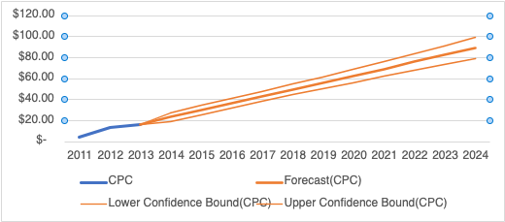
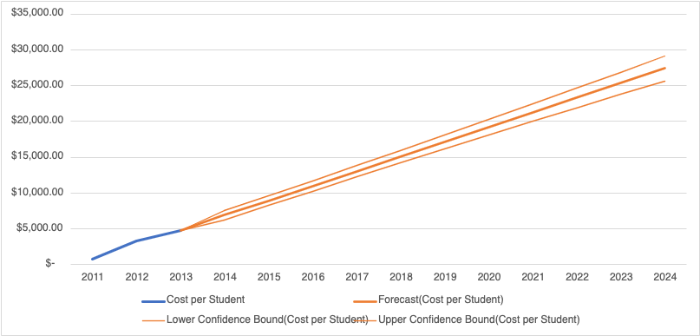
Business Analytics: Developing Enhanced Marketing Strategies from Previous Campaigns Results
Forecasted CPC 2024: $88.92
Forecasted CPS 2024: $27,391.25
Key Geographic Regions: New York, Texas, California, and other US metro areas
Campaign Key Words: “MBA”, “Top MBA”, “Online MBA”
Key Advertising Window: 17:00 – 23:00 Sat-Thurs
Notes:
The results were presented in a report with visualizations to clearly communicate the actionable insights within the findings of the analysis
The first being a forecasted cost per click in 2024 at $88.92, and a forecasted cost per student in 2024 at $27,391.25. These metrics help determine the campaign's efficiency, effectiveness, and overall return on investment.
The next insights include key features from previous campaigns such as key geographic regions from previous successful campaigns such as New York, Texas, California, and other US metro areas. This gives and idea where to specifically geographically target future campaigns.
The next key feature from previous successful campaigns were key words such as “MBA”, “Top MBA”, “Online MBA” identified to use in future campaigns to enhance the ability to recruit students.
The last key feature identified was the optimized time window for the campaign, this was found to be between 5 PM and 11 PM Saturday through Thursday and this was again found using data from previously successful campaigns.
Data Collection and Exploration
Cleaning and Identifying Features For Analysis
Google Analytics
Finding significant variables within the data
Need to make sure information is handled ethically
Using Analytical Techniques to Explore Actionable Insights
Prediction Analysis
Using google analytics
Finding significant variables within the data
Applying Strategies Generated from Machine Learning Techniques
Business Strategies and Suggestions to maximize business Outcomes
Marketing strategy recommendations
Optimizing the Model To provide the optimal strategies and predictions for the future
Visualization of Results and Creating Actionable Business Insights
Visualization of the Prediction Analysis
Graphical Visualizations
Tables of Results
Recommending Future Market Strategies

Slide 7
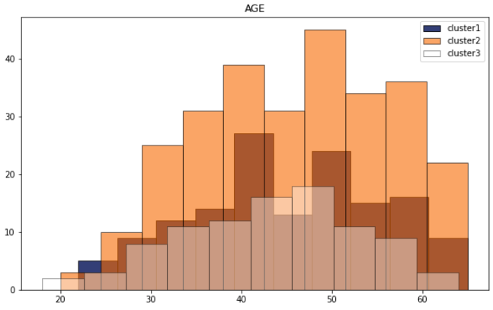

Marketing Analytics: Segmentation for Business Intelligence Insights
Goal: Generate Business Insights and Recommend Strategies from Segmented Customers
Identified Key Features within Clusters
Correlation Analysis within Segments for Further Insights
Notes:
The next project I want to discuss comes from my Marketing Analytics Class. The goal of the project was to generate Business Insights and Recommend Strategies from Segmented Customers in a simulated environment. Key Features and Correlations within clusters were identified to identify actionable insights to convert to business strategies for our business of interest: Wahoo Fitness. In this case the data was sourced from an internal customer survey where customers answers were collected by Wahoo fitness to build future business strategies. This project used a combination of R and Excel to perform the analysis. (and) All customer identification was anonymized, and all other ethical considerations were observed when undergoing the analysis.
The visualization on the right shows the demographic break down within clusters, this was useful for understanding the current customer base of Wahoo Fitness and allowed for us to generate strategies mentioned in the following slide. Other customer metrics explored were the psychometrics and the workout equipment currently owned by the customer base, again used to generate business insights that Wahoo could leverage in the future.
Used Excel, and R to Perform the Analysis in this Project
Goal: Generate Business Insights and Recommend Strategies from Segmented Customers
Identified Key Features within Clusters
Correlation Analysis within Segments for Further Insights
Data was from an internal customer survey
Marketing Analytics: Segmentation for Business Intelligence Insights
Data Collection and Exploration
Cleaning and Identifying Features For Segmentation
Psychographics
Demographics
Need to make sure customer information is handled ethically
Using Analytical Techniques to Explore Actionable Insights
K-Means Clustering
Applying Strategies Generated from Machine Learning Techniques
Business Strategies and Suggestions to maximize business Outcomes
Product Recommendations
Feature Recommendations
Growth Strategy
Point
Visualization of Results and Creating Actionable Business Insights
Visualization of the Segments
Correlation insights (USING R)

Slide 8
Marketing Analytics: Segmentation for Business Intelligence Insights Results
Identified 3 distinct customer segments for consideration
Segment 1: Athletic for Pure Pleasure – (“past-time-ers”)
Segment 2: Health- & Sports-focused – (“health conscious”)
Segment 3: Pure Competition – (“athletic lifestyle”)
New Products & Features
Social Media – shareable workouts, workout leaderboards between global users & friends
Nutrition Tracking – integrations with other companies (B2B engagement)
Product Warranties / Insurance / Customization - watch faces & bands, custom colors, sports franchise partnerships
Growth Strategies
Higher subscription volume – upcycling free app users to paid subscribers
Product line expansion
Software opportunity – enhancing app ecosystem to create universal Wahoo Health dashboard
App Advertising – Paid search & In-app ads
Capture new customers in the lower age ranges (20-30), and convert them to long-term customers
Notes:
The resulting insights found were presented as a presentation with visualizations to allow easily digestible insights to be conveyed to stakeholders.
The first insight was 3 distinct customer segments were identified for Wahoo Fitness enabling them to efficiently and effectively target their market strategies based on specific criteria.
Segment 1: Athletic for Pure Pleasure – (“past-time-ers”)
Segment 2: Health- & Sports-focused – (“health conscious”)
Segment 3: Pure Competition – (“athletic lifestyle”)
Using the insights generated from the demographic, psychographic and current equipment customers used in each segment, new products and features were recommended to Wahoo Fitness such as:
Social Media Integration with shareable workouts, workout leaderboards between global users & friends. The next being Nutrition Tracking with integrations with other companies (B2B engagement) and lastly Product Warranties / Insurance / Customization such watch faces & bands, custom colors, sports franchise partnerships
Lastly growth strategies were recommended to Wahoo using the insights gathered from the customer segmentations. To promote growth within the current and new customers, it was recommended that Wahoo Fitness endeavor to upcycle fee app users to a paid subscription model attached to their products. This would provide an opportunity to generate advertising revenue in a free application given to their less serious customers in segment 1 and generate income from their more dedicated customer base in segment 3 from paid subscriptions with the goal of not only increasing customer lifetime value by converting customers in segment 1 to be more like segment 2 and 3 but also retain their current customers by improving on their products and services. And finally, it was found that capturing new customers in the lower age ranges (20-30) would increase their customer base and incorporate them into the Wahoo Fitness environment to convert them from new customers to long-term customers.
Marketing Analytics: Segmentation for Business Intelligence Reccomendations
Frist: include shareable workouts, workout leaderboards between global users & friends with the goal of increasing customer retention (or reduce churn), engagement and a natural recruitment of new customers through leveraging the networks and friend groups of current customers.
Second recommendation to increase metrics such as customer lifetime value and customer retention is to offer new products and features. There are not a lot of gaps in the customer base regarding fitness equipment, but product customization could be an avenue to incentivize those already owning equipment to purchase cosmetic add-ons, or small improvements as several segments have an interest in maintaining their own equipment.
Lastly to promote growth within the current and new customers, it’s recommended that Wahoo Fitness endeavor to upcycle fee app users to a paid subscription model attached to their products. This would provide an opportunity to generate advertising revenue in a free application given to their less serious customers in segment 1 and generate income from their more dedicated customer base in segment 3 from paid subscriptions with the goal of not only increasing customer lifetime value by converting customers in segment 1 to be more like segment 2 and 3 but also retain their current customers by improving on their products and services.

Slide 9

Applied Machine Learning : Predicting the Winner of The Rugby World Cup
Goal: Apply Multiple Machine Learning Models to Predict a Real-World Outcome
Data found on Kaggle
Machine Learning Models:
Association Rule Mining
Naïve Bayes Classifier
Decision Tress
Notes:
The next project I am going to discuss comes from my Applied Machine Learning Class where I used multiple techniques to attempt to predict the winner of the 2023 World Rugby Cup. I personally love the sport, and that initially interested me but upon further research I found that the Rugby World cup is the third most popular international sports competition in the world, and winning large international sports competitions can have significant economic, cultural and prestigious outcomes. This furthered my interest in predicting the winner, and I was all too eager to apply newly learned machine learning techniques to this problem.
The data was found on Kaggle and open to be used for research purposes and was used after going through an iterative process of data cleaning, exploratory analysis, and feature engineering. The machine learning models used in the analysis include Association Rule Mining to identify important factors for winning teams, a Naïve Bayes Model to classify winners using the data and features generated at hand, and lastly Decision trees to model the winner of the Rugby World Cup using the participating teams and data available.
Applied Machine Learning : Predicting the Winner of The Rugby World Cup
Data Manipulation to Generate Useful Features
Exploratory Data Analysis
Cleaning
Feature engineering
Use Multiple Analytical Techniques to Find Data Driven Insights
Association Rule Mining
Classification using Naïve Bayes
Correlation Analysis
Decision Trees
Evaluate Models Created from each Analytical Technique
Analyzing the lift and support from Association Rule Mining
Measuring accuracy and using cross validation to evaluate the Naïve Bayes Model
Pruning Decision Trees, altering key features used in Decision Trees and performing 10-fold cross validation to measure model accuracy.
Visualize and Communicate Results of the Comprehensive Analysis
Association Rule Mining Plots
Item Frequency Plot visualizing key features used in determining rules found within the Association Rule Mining Analysis
Tables of Key Features used in Naïve Bayes Model
Correlation heat map
Decision Trees visualizations showing the how decisions were determined from the root nodes to terminal nodes.

Slide 10
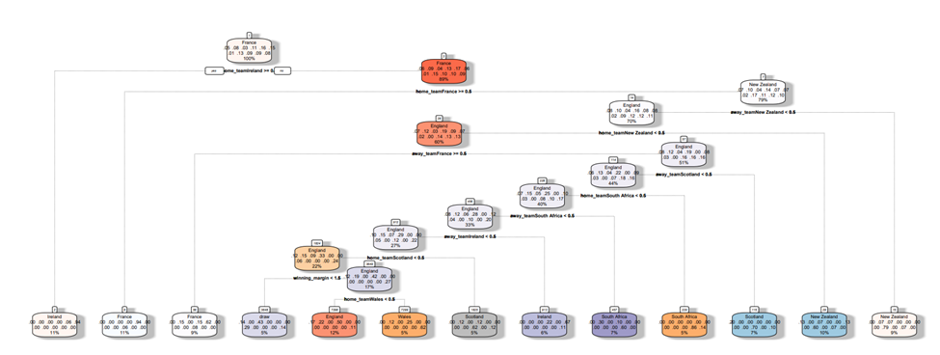
Applied Machine Learning : Predicting the Winner of The Rugby World Cup Results
Association Rule Mining found the most important rule for winning was home team advantage
Naïve Bayes Classification using the data to determine a match winner: 60% accuracy
Decision Trees Analysis: Determined France had 20% chance of winning (highest from participating teams)
Decision Tree Accuracy: 53.33% (CP =0.02)
Notes:
The project was presented as a presentation with visualizations to allow easily digestible insights to be conveyed to stakeholders and interested parties.
The analysis predicted France to win the RWC 2023, as they were the best-performing team since RWC 2019 and the host nation for RWC 2023. the decision tree models consistently identified France as the top performer in both initial and improved models. Other top teams included Ireland and New Zealand.
Multiple Attempts to improve the Naïve Bayes Classification and Decision Tree Analysis Accuracy of the Models such as LaPlace smoothing and 10-fold cross validation with respect to the Naïve Bayes Model and pruning, iterating across an increasing complexity parameter (cp) and 10-fold cross validation for the Decision Trees.
The performance of the analysis was unfortunately limited due to the data at hand. The analysis could be improved such as more information from match data included within the analysis. This could include the number of penalties from each participating team, the number of yellow or red cards from each team, and the number of injuries before and during the game could improve the analyses within the project. Other categorical information that could be included could be if the first- or second-string team was playing, the weather on the day of the match (raining, heat, wind speed) or the field formation the team adopts when playing in a match. This would not only aid in improving the current models but also widen the number of models one can apply to the data.

Slide 11

Deep Learning: Recursive Neural Networks In Financial Markets
Goal: Apply Deep Learning Techniques and Compare to Traditional Machine Learning Methods
Deep Learning Models:
“Simple” Neural Network as a baseline deep learning model
Recurrent Neural Networks
Long Short-Term Memory (LSTM)
Gated Recurrent Unit (GRU)
Traditional Models:
Random Forest
Data Procurement:
Y-Finance’s API
Past 10,000 days of trading data of a specific stock
Data of interest pulled:
Date
opening price of the stock
closing price of the stock
high and low prices of the stock
adjusted close price
volume
Notes:
This next project highlights the use of Deep Learning techniques to predict financial markets while comparing them to more traditional machine learning models. The data was acquired in real time using Python and yahoo finance’s API where the past 10,000 days trading was collected along with other features of interest. These other features include the date, the opening price, the closing price, the high and low prices for that date, the adjusted close price and the trading volume for that day. All data collected is publicly available, and all ethical considerations were observed. (No insider information was used in the analysis otherwise the models would have performed a lot better.
The deep learning models used in the analysis include a simple neural network to be used along with the random forest model as a baseline to compare with the Recurrent Neural Networks used in the analysis. The simple neural network was constructed with just 16 dense layers and a Relu activation function. The two Recurrent Neural Networks used were a Long Short-Term Memory (LSTM) model and a Gated Recurrent Unit (GRU) model.
The traditional
Used Python for the analysis in this project
Deep Learning: Recursive Neural Networks In Financial Markets
Using Apis to Collect Financial Data (Top Performers across Industries)
Used Yahoo Finance API to gather select data from Yahoo Finance Database
Use RNN’s to Predict Stock Performance
Tensorflow and Keras to build Simple Neural Network (Relu and Dense Layers), GRU, LSTM Neural Networks
Model Evaluation and Implementation
Compare Train set, Test set and Validation set
Modifying hyperparameters to improve the learning ability of the Neural Network
Evaluated Models using Mean Absolute Error
Used the top performing Model to build a Price Predictor against
Comparing Models: GRU vs LSTM vs Random Forest Classifier
Compare classical Machine Learning Techniques to the different Neural Network Models using the MAE of each model.

Slide 12
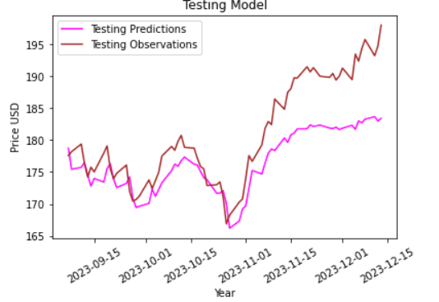
Deep Learning: Recursive Neural Networks In Financial Markets Results
Mean Absolute Error (MAE): how far way the prediction value is from the true value in dollar amounts
Initial RNN Models’ Performance was good but over time the prediction broke down
Model Performance:
Random Forest Accuracy: 52.4%
“Simple Neural Network” MAE: 47.55
LSTM MAE:3.08
GRU MAE: 3.01
Notes:
The Random forest model’s performance was measured using accuracy and the deep learning models were measured using Mean Absolute Error (MAE) or how far way the prediction value is from the true value. In this case this was a difference in dollar amounts between the predicted and true value of the stock price.
While the LSTM and GRU models outperformed the traditional and simpler model, they are not suitable to be used as stock predictors, this can be seen with the deviations between predicted and actual observations over time in the visualization in the bottom right. This is due to the complex and dynamic nature of financial markets where a combination of external factors influences the stock price.

Slide 13
Natural Language Processing: Predicting Sentiment using NLP Techniques
Goal: Train a Naïve Bayes Classifier Model to classify sentiment of movies reviews using natural language processing
Data: Found in the form of a corpus of text files organized by sentiment (positive/negative)
Feature Sets Generated For Analysis:
Bag of Words
Parts of Speech
Text Statistics
Bigrams
VADER- pre-defined feature set
TF-IDF tokenized feature set
Notes:
This next project involves the use of Natural Language Processing Techniques to train a Naïve Bayes Classifier Model to classify sentiment of movies reviews
The data was found on Stanford’s AI lab site and was available for free use and research purposes. All reviewer sensitive information was removed, and the data was available in the form of text corpuses organized by sentiment (either positive or negative sentiment).
Python and the Natural Language Processing Toolkit were used in the analysis of the project. The Naïve Bayes Classifier included a 5-fold cross validation, and the classifier was applied in 36 iterative experiments where different feature sets were used to find the top performing classifier.
The different feature sets used include a bag of words feature set, a parts of speech features set created using the bag of words set, a text statistics set such as number of negated words and capitalized letters, a bigrams feature set, a predefined Valence Aware Dictionary and Sentiment Reasoner or VADER feature set, and lastly a Term Frequency-Inverse Document Frequency or TF-IDF feature set.
Used Python for this analysis in the project
Naive Bayes Classifier
5 Fold Cross Validation
12 Experiments
36 Trained Classifiers
Over 5 hours to run
Feature Sets Generated Suing Python and the Natural Language Tool Kit For Analysis:
Bag of Words
Text Statistics
Bigrams
VADER- pre-defined feature set
TF-IDF tokenized feature set

Slide 14
Natural Language Processing: Predicting Sentiment using NLP Techniques Results
Tested 36 Classifiers of different and combined feature sets
Top Performing Naïve Bayes Classifier used a combination of feature sets:
Vader feature set, the TF-IDF feature set, and the bag of words feature set but with nouns removed from the POS tags
Average Accuracy: 85%
Notes:
The results of the analysis were interesting. Of the tested 36 Classifiers, the top performing classifiers used a combination of feature sets.
For example, the Top Performing Naïve Bayes Classifier used a combination of the Vader feature set, the TF-IDF feature set, and the bag of words feature set but with nouns removed from the POS tags with an
Average Accuracy: 85%.

Slide 15
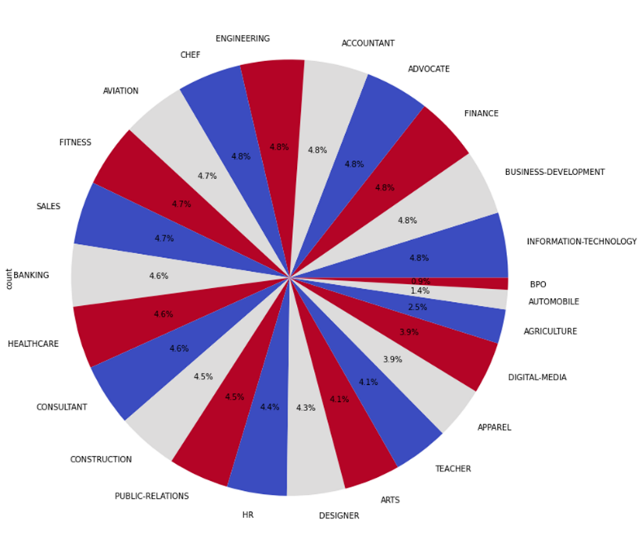
Text Mining: Filtering Resumes Using Text Mining
Goal: Apply Machine Learning and Text Mining Techniques to Filter Resumes using Key Features
Data: Combined two sources of text files organized by industry
Used TF-IDF Vectorizer to instantiate the concatenated data
Models of Interest:
K-Nearest Neighbor (KNN)
Latent Dirichlet Allocation (LDA)
Support Vector Machines
Random Forest
Notes:
This last project was from my Text Mining class where the goal was to apply machine learning and Text Mining Techniques to Filter Resumes using Key Features.
The data was found on Kaggle for free use in research where two corpus of text files were concatenated for a more comprehensive pool of resumes organized by industry. The industry make up of the roughly 3,500 resumes can be viewed visually in the bottom right. Standard data cleaning for text mining was done such as removing stop words and using a TF-IDF Vectorizer to instantiate the data and then pass the data through the models of interest including a K-Nearest Neighbor (KNN) model, a Latent Dirichlet Allocation (LDA) model, Support Vector Machines, and a Random Forest model.
The KNN model would be used outright to investigate if the resumes could be categorized by industry.
The topics derived from the LDA model were then used features for the Support Vector Machine and Random Forest models. The SVC and Random Forest models were then be evaluated with respect to classifying the resumes with and without the LDA topics as features.
Text Mining: Filtering Resumes Using Text Mining
Data Collection and Exploration
Combined two sources of data
Cleaning and formatting to a uniform format
Stop words removed
Tf-IDF vectorization
Exploratory Data Analysis
Need to make sure resumes are handled ethically
Developing Data Driven Strategies to Generate Actionable Insights
Used Two different models (LDA and KNN clustering) to determine classifying features
Applying Data Driven Strategies via Analytical Techniques and Models
Used Support Vector Machines and Random Forest Models to then take the previous labeled features and investigate performance
Data Visualization
Tables of Key Features and Results of KNN model
Word Cloud Visualizations

Slide 16
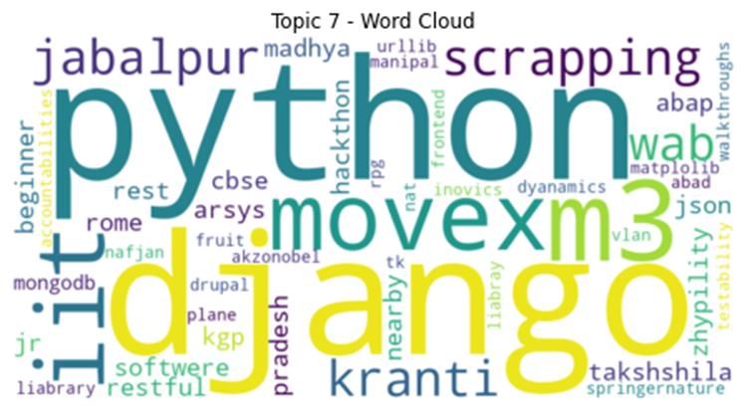
Text Mining: Filtering Resumes Using Text Mining Results
KNN Model: 65% accuracy, 67% precision and 65% recall
SVC using LDA topics as labels: 27.97% Accuracy
Random Forest using LDA topics as labels: 53.76% Accuracy
SVC no LDA labels: 73.91% Accuracy
Random Forest no LDA labels: 74.05% Accuracy
It was found the best method to filter resumes was relying on the traditional SVC and Random Forest models
Notes:
The results of the project were interesting, the KNN Model showed poor results with an accuracy of 65%, a precision of 67% and a 65% recall. Following that same trend the SVC and Random Forest Models using the LDA topics as features showed poor performances when classifying the resumes based on industry. An example of a word cloud visualization can be seen in the bottom left showing why applying the LDA topics to the models would result in such a poor performance. Using the SVC and Random Forest models without the LDA topics as features performed significantly better with an accuracy of 73.91% and 74.05%, respectively. Ideally these performances could be improved on, this could be achieved by additional cleaning methods such as an extended stop word list.

Slide 17
Summary of Learning Outcomes and Conclusion
Data Collected From Multiple Sources:
Kaggle
APIs for real time data
Google Analytics
Programing Languages:
R and Python
Communication and Visualizations
Ethic Considerations
Machine Learning, Predictive Models, and Other Techniques:
Predictive Analysis
Association Rule Mining
Classification using Naïve Bayes
Correlation Analysis
Decision Trees
NLP Analytical Techniques
Text Mining Techniques
Tensorflow/ Keras for Deep Learning
Notes:
Data was collected ethically from multiple sources including Kaggle, Google Analytics, different APIs and university sites. Both R and Python were used to apply machine learning techniques across the different projects. These Machine learning, predictive models and other techniques include:
Predictive Analysis
Association Rule Mining
Classification using Naïve Bayes
Correlation Analysis
Decision Trees
NLP Analytical Techniques
Text Mining Techniques
Tensorflow/ Keras for Deep Learning
Lastly, actionable insights and results from multiple analyses were reported in multiple formats, with added visualizations to achieve the ultimate goal of delivering clear actionable insights for stakeholders.

Slide 18
Thank You
Logan Roach
loroach@syr.edu
logan.roach587@gmail.com
GitHub
Portfolio Documents - GitHub
Notes:
Thank you all for taking the time to listen to my journey through the Applied Data Science Masters Program. Your attention and interest mean a lot to me.
I hope my experiences and insights have been valuable.
If you have any questions or would like to discuss anything further, please feel free to reach out.
Thank you once again for your support and for being a wonderful audience

Slide 19
References
Demonstration Learning Outcome Image
Whitman School Image
Wahoo Image
RWC Image
Yahoo Image

